Slide 1

Belong - Data Engineer Role - Code test
Brad Zhang

Slide 2






High-level documentation
1 check_header
2 Load_csv
3 Check_columns
4 Check duplicates
4.1 Check duplicate records
5 Check Na
6 Anomalies
7 create new cols
Preprocessing
1 import dataframe to MySQL
2 Check records before installation
3 Top 10 locations by day
4 Top 10 locations by month
5 decline and growth by year
Pedestrian_Counting_System_-_Sensor_Locations.csv
Processing
Pedestrian_Counting_System_-_Monthly__counts_per_hour_.csv
Export data
Visualization

Slide 3
Tests & Founds
1 check_header
Pass
2 Load_csv
Pass
3 Check_columns
Pass
4 Check duplicates
Pass
4.1 Check duplicates records
No Pass 12240 duplicate records (which means more than one record for a sensor at the same hour)
I don’t have time to consult the data provider about how these values happened, so I will not adjust these values and they will be added up in the following processing.
5 Check Na
Pass for Pedestrian_Counting_System_-_Monthly__counts_per_hour_.csv
No Pass for Pedestrian_Counting_System_-_Sensor_Locations.csv
Col ‘note’ has 76 Na values
Col ‘direction_1’ has 8 Na values
Col ‘direction_2’ has 8 Na values
These Na values will not affect the outcome of the analysis so no adjustments
6 ‘Year’ ‘Month’ ‘Mdate’ ‘Day’ ‘Time’ Anomalies
Pass
7 Sensor records before installation check
No Pass
Sensor_id 7 has 36983 records
Sensor_id 19 has 24 records
Sensor_id 21 has 24 records
Sensor_id 23 has 24 records
Sensor_id 24 has 24 records
Sensor_id 31 has 24 records
Sensor_id 35 has 41926 records
Sensor_id 37 has 240 records
Sensor_id 39 has 42148 records
Sensor_id 50 has 3287 records
I don’t have time to consult the data provider about how these values happened, but according to my previous experience, I choose to filter these records.

Slide 4
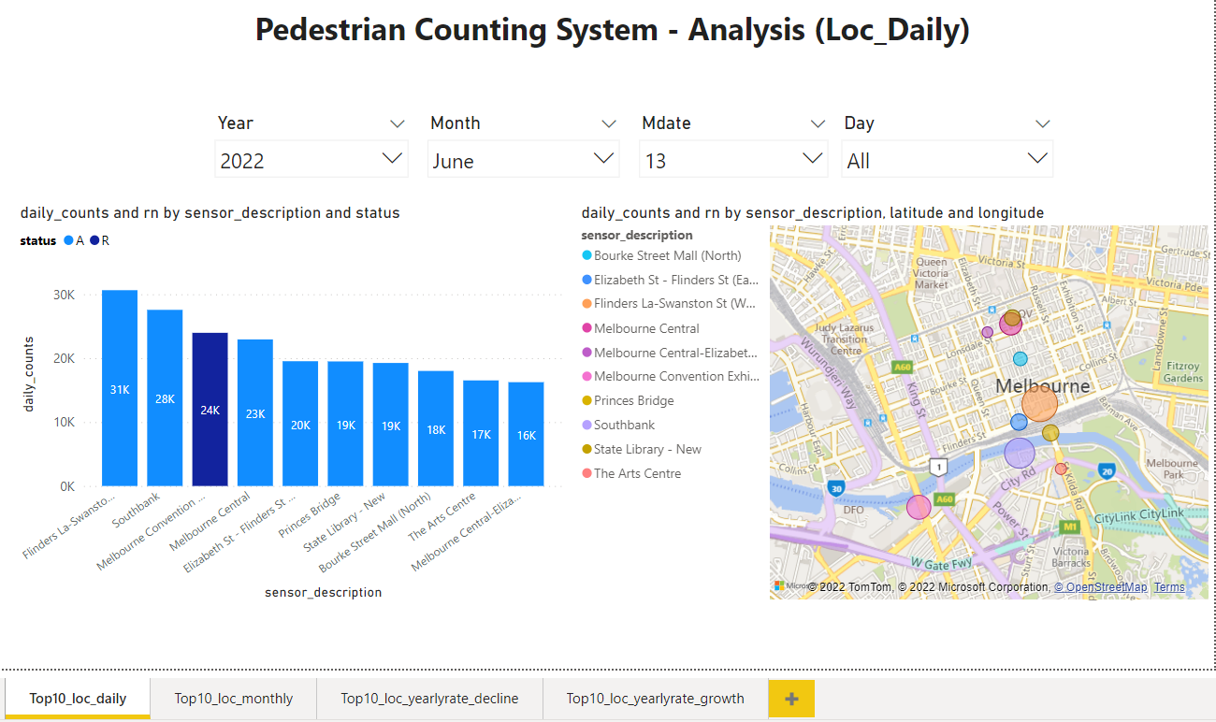
Codes & Visulization & outputs P1
All Codes including preprocess and process
were written in the Jupyter notebook. As following:
Top 10 (most pedestrians) locations by day

Slide 5
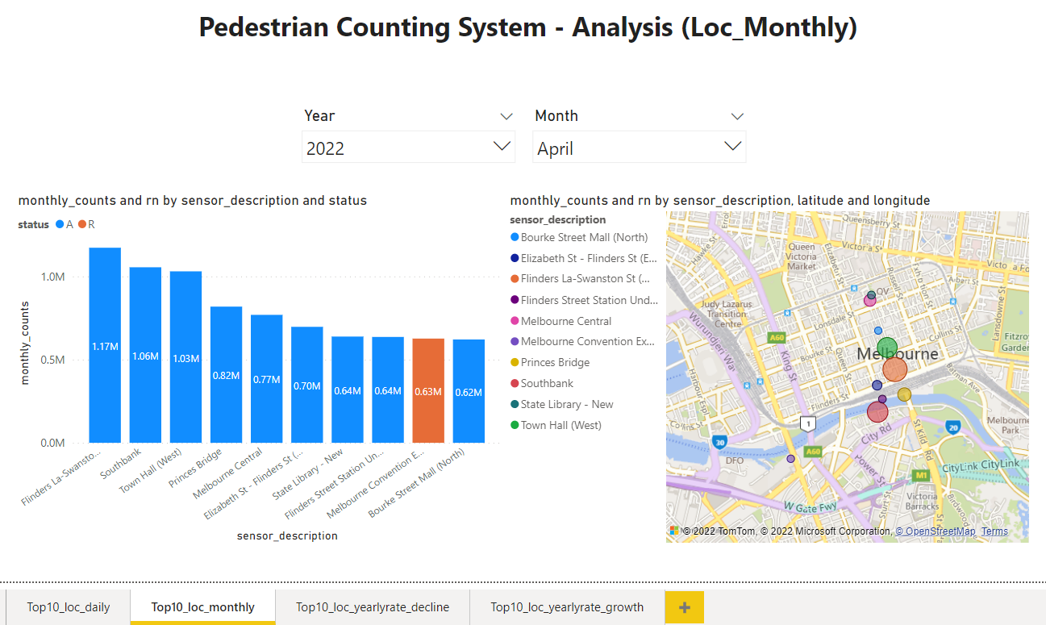
Codes & Visulization & outputs P2
Top 10 (most pedestrians) locations by Month

Slide 6
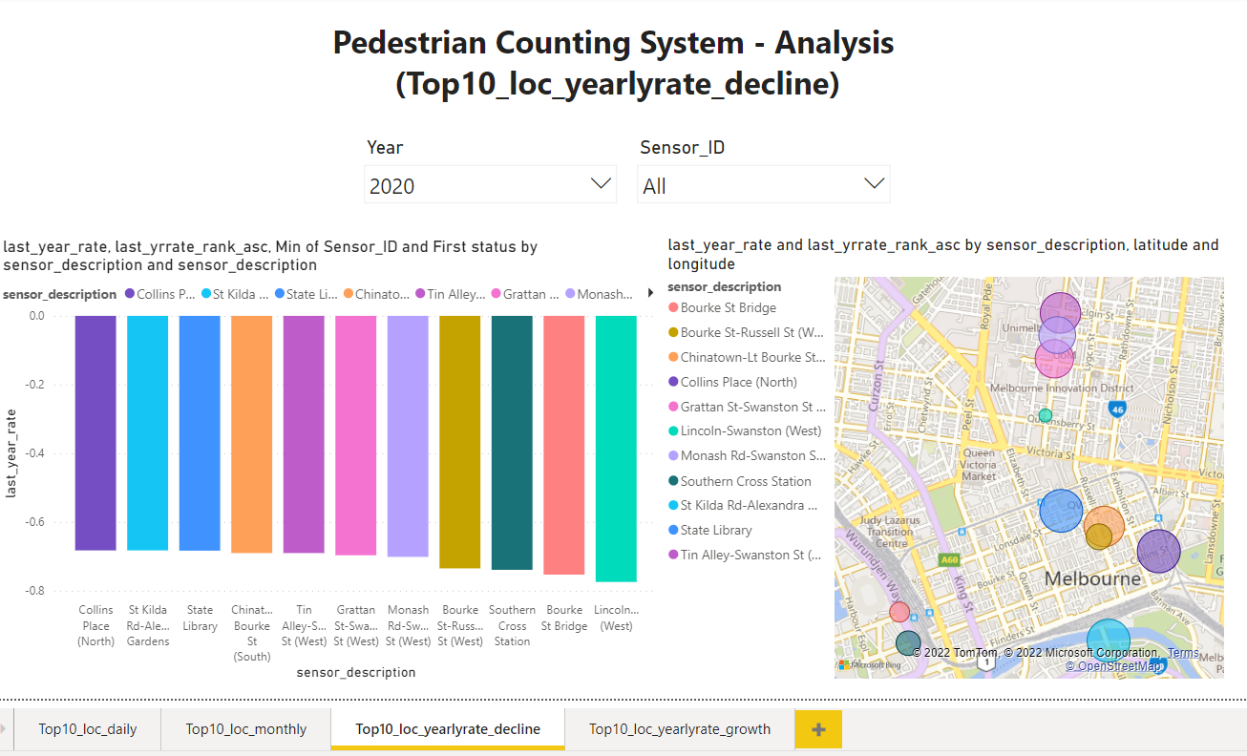
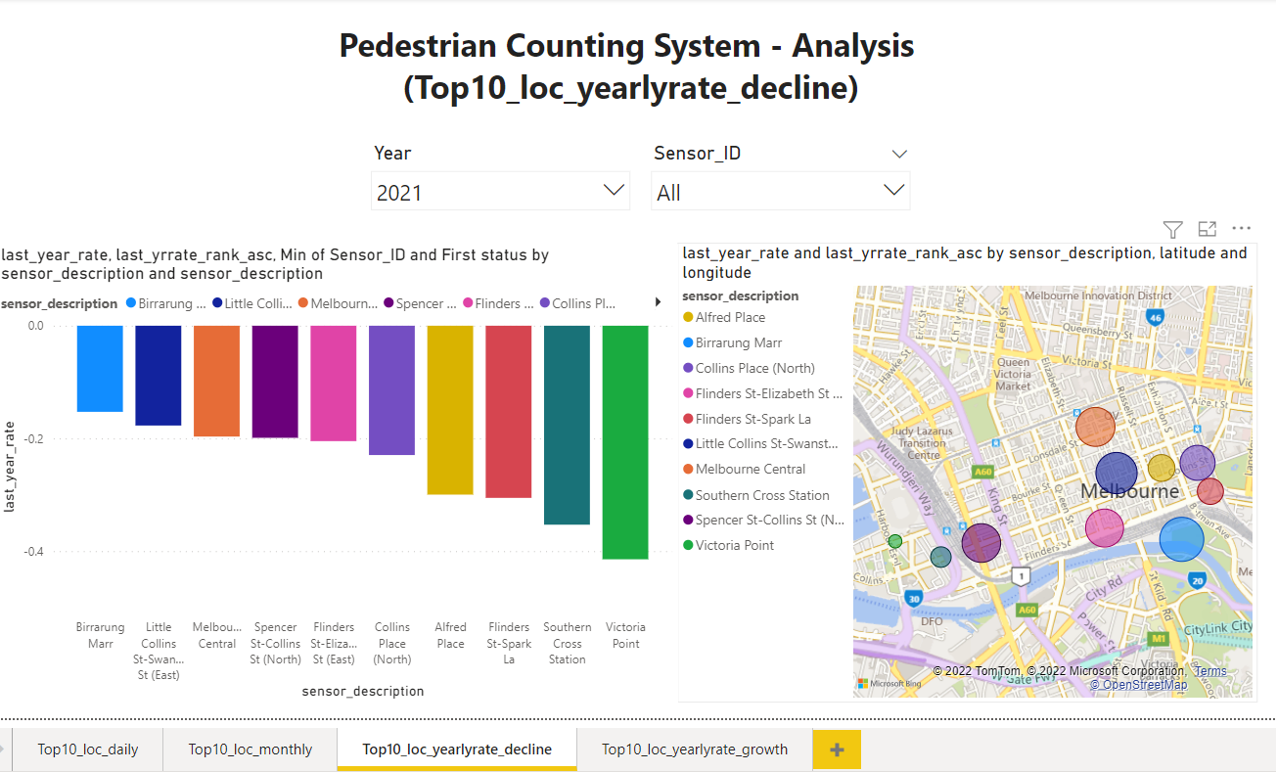
Codes & Visulization & outputs P3
Which location has shown most decline due to lockdowns in last 2 years
From 2019 to 2020 the most declined location is
Lincoln-Swanston (West)(the sensor status is ‘A’ installation time is 26/06/2018)
PS: Records from sensors that didn’t work for a whole year are filtered.
From 2020 to 2021 the most declined location is
Victoria Point (the sensor status is ‘A’ installation time is 23/04/2009)
PS: Records from sensors that didn’t work for a whole year are filtered.

Slide 7
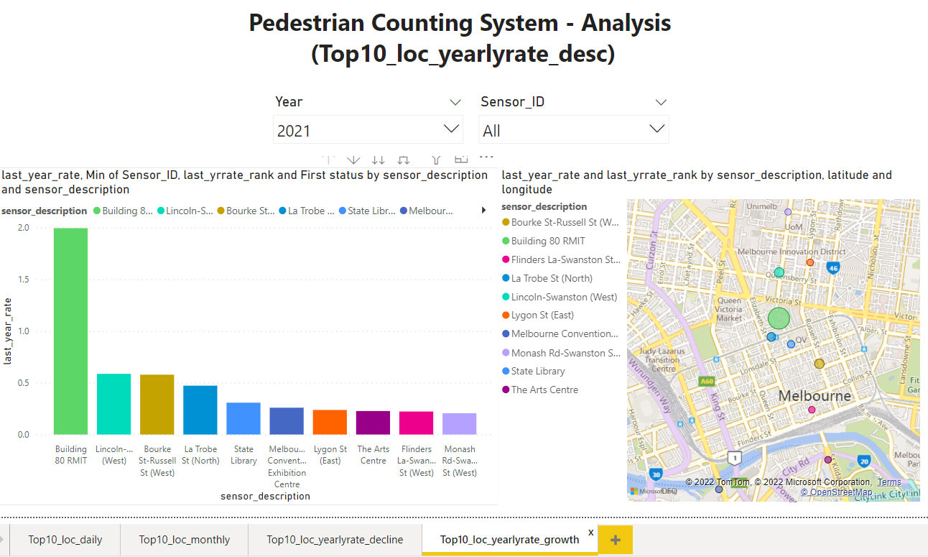
Codes & Visulization & outputs P4
Which location has most growth in last year
From 2020 to 2021 the most grown location is
Building 80 RMIT, (the sensor status is ‘A’ installation time is 13/02/2019)
PS: Records from sensors that didn’t work for a whole year are filtered.

Slide 8
What other metrics can be derived from these data sets
Pedestrians counts of locations from the different time period of day like morning, noon, afternoon, eve, night, late night
Pedestrians counts of locations from different weekdays like Monday, …, and Sunday. Can combine with the 1st idea.
Pedestrians counts of locations on special days like holidays, events etc,.
Pedestrians counts of locations on different weather like raining, sunny, windy or with different temperatures or with different seasons

Slide 9
Describe the data model and include a diagram
Actually, I created three data models which are stored in an excel file
1. top10_loc_day
2. top10_loc_day
3. top10_loc_day
Year | int64
Month | object
Mdate | int64
Day | object
Sensor_ID | int64
sensor_description | object
sensor_name | object
Date_int | int64
daily_counts | float64
status | object
latitude | float64
longitude | float64
installation_date_int | int64
rn | int64
Year | int64
Month | object
Sensor_ID | int64
sensor_description | object
sensor_name | object
monthly_counts | float64
status | object
latitude | float64
longitude | float64
installation_date_int | int64
rn | int64
Year | int64
Sensor_ID | int64
sensor_description | object
sensor_name | object
yearly_counts | float64
last_yearly_counts | float64
last_year_rate | float64
last_yrrate_rank | int64
last_yrrate_rank_asc | int64
status | object
latitude | float64
longitude | float64
Raw csv data
Pedestrian_Counting_System_-_Sensor_Locations.csv &
Pedestrian_Counting_System_-_Monthly__counts_per_hour_.csv
CSV -> dataframe
df_ped_cnts
df_sensor_info
DF -> mysqlTables
top10_loc_day
top10_loc_month
loc_yearcomparison_rank
mysqlTables -> DF
df_top10_loc_day
df_top10_loc_month
df_loc_yearcomparison_rank
Excel

